Slide 1
Final Project Presentation
MG
Alvin Chen, Gabriel Fleming, Mark Garas, Kaiqi Yang

Slide 2
Agenda
MG
Introductions
Alvin
Data/Data Overview
DBWorker.java Class and Outputs
Gabriel
Internal Class Design
SearchQuery.java and DataTypeInfo.java
Mark
Webpage and Servlet
Kaiqi
GUI Interface, Input, and Output
Challenges
Successes
Summary

Slide 3
Introductions
MG
Alvin Chen – Code for managing/getting info from database
Gabriel Fleming – Other Internal Classes
Mark Garas – Web interface
Kaiqi Yang – GUI interface

Slide 4
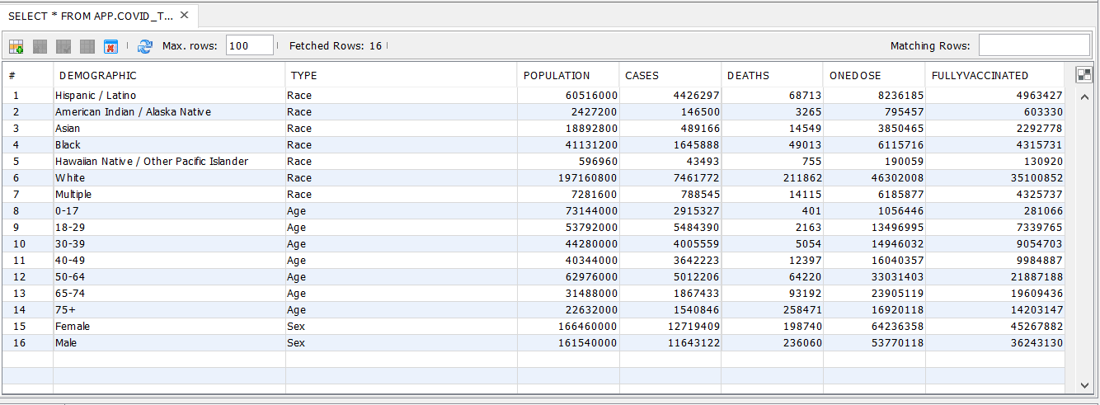
Data
AYC

Slide 5
Data Overview
AYC
Demographic
Demographic Type
DataType
5 main data types
Data Sources:
https://covid.cdc.gov/covid-data-tracker/#demographics
General data
https://covid.cdc.gov/covid-data-tracker/#vaccination-demographic
Vaccine data

Slide 6
DBWorker
AYC
Database Connection
Methods:
getEntry()
getAllData()
sumAllData()

Slide 7
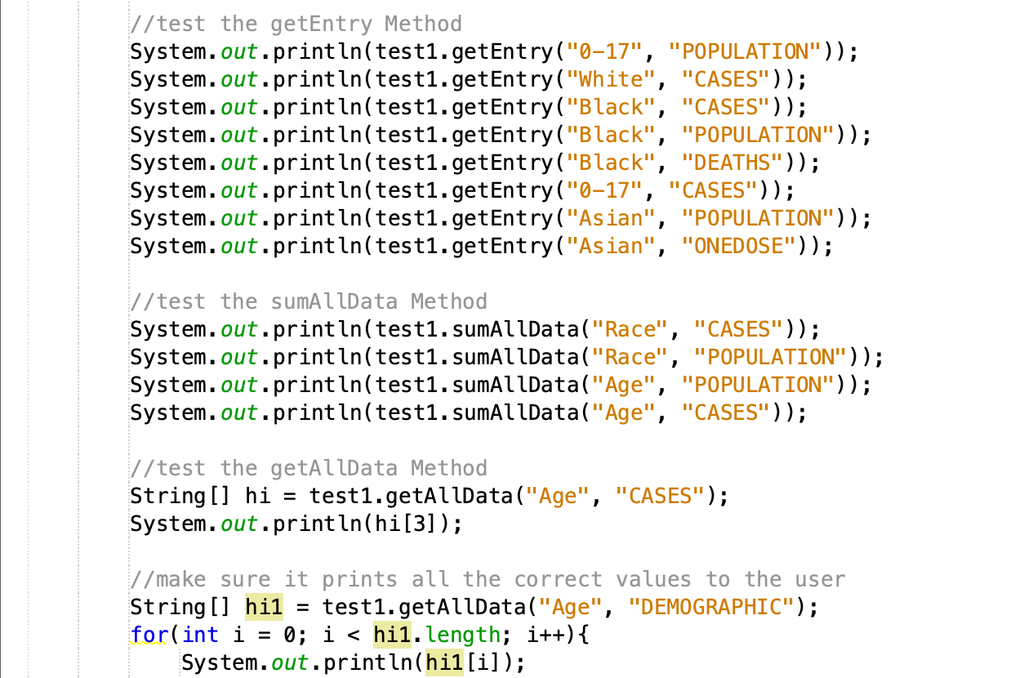
DBWorker – Example Outputs/Situations
AYC
Outputs

Slide 8
Internal Class design
G.F.
Interface classes
SearchQuery
DataTypeInfo
DBWorker
Database

Slide 9
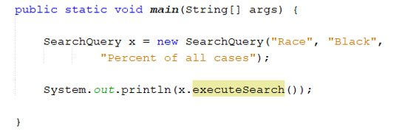
SearchQuery
G.F.
Class used by the interfaces to search for data
Example Search – Find the percent of 65-74 year olds who are vaccinated
Handles internal calculations
Public String executeSearch() - method used to get the result to the search entered on the interface
Additional methods to get/set class attributes and to get lists of valid values for different datatypes
Sample program:
Output:
Search type: Percent of all cases Search Demographic: black people Search Result: 10.97%

Slide 10
DataTypeInfo
G.F.
Supporting class for SearchQuery
Maps certain dataTypes Strings selected on the interfaces to data that is more useful to searchQuery
"Percent of all cases" - makes sense to the user, but not to SearchQuery
Two corresponding strings are mapped to:
1. statisticType (e.g. "PercentOfAll")
2. dataCategory (e.g. "CASES")

Slide 11
Web Page (CDCJSP.jsp)
MG
Simple user interface
Uses radio buttons, dropdown menus
Takes up to 2 search queries
Submits all the info to the servlet
Gets an output string ready to be displayed from the servlet

Slide 12
Servlet
MG
Gets the user input from the JSP
Makes a new SearchQuery object and uses its methods to get a results string
Makes the string more readable on the HTML/JSP page but adding spaces
Resets form on submission (with the results from the last search)

Slide 13
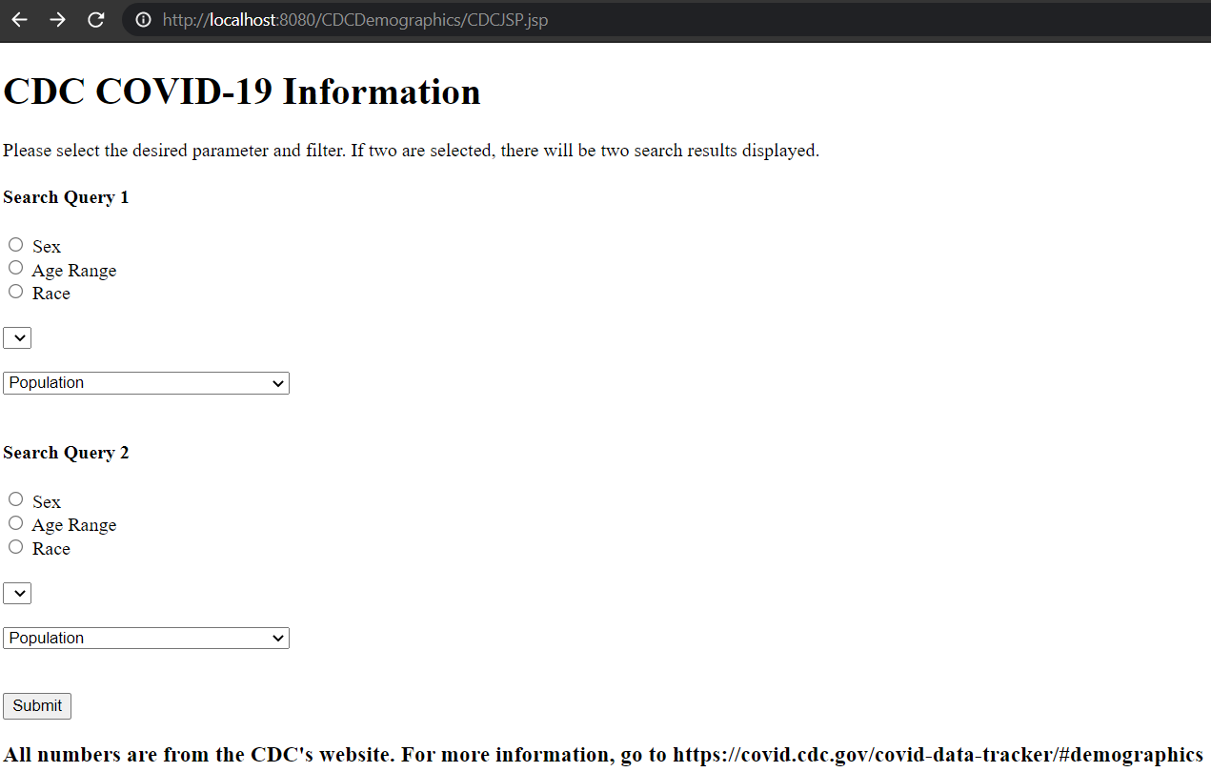
MG

Slide 14
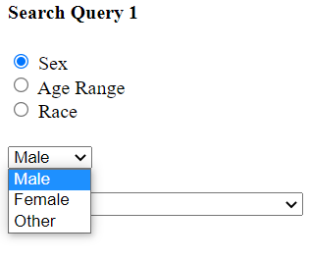
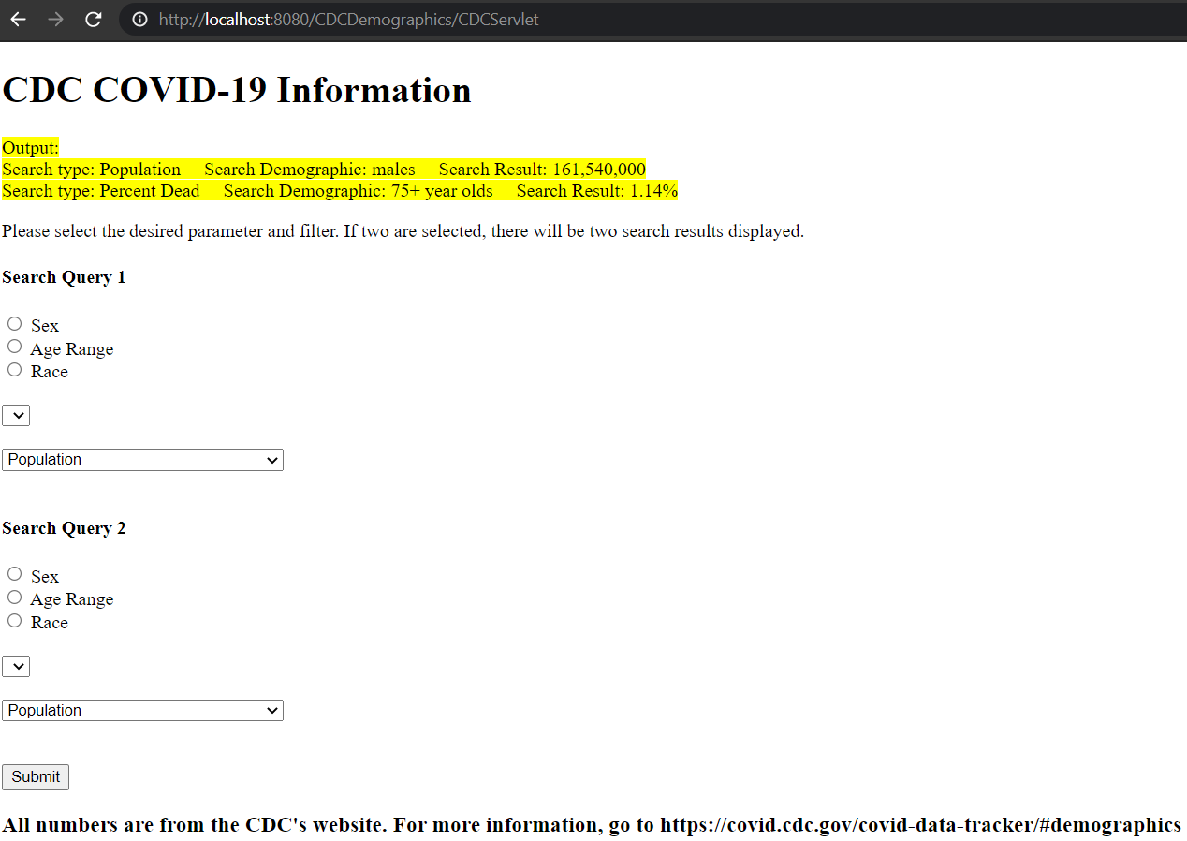
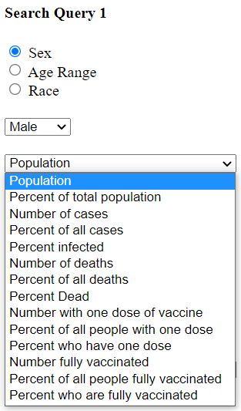
MG

Slide 15
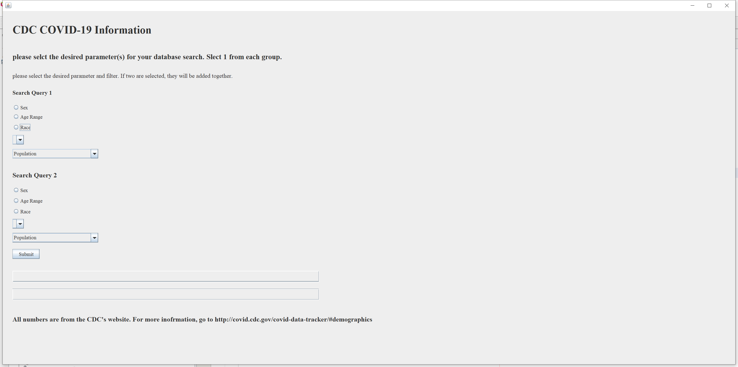
GUI：Interface
KY

Slide 16
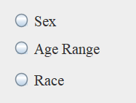
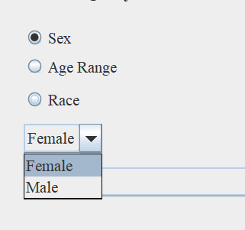
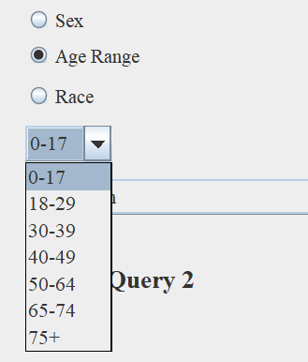
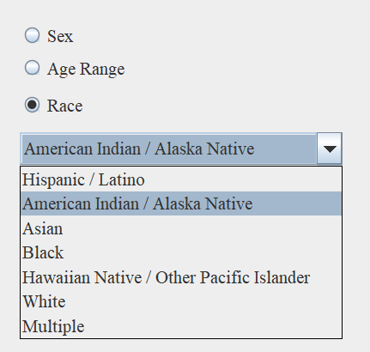
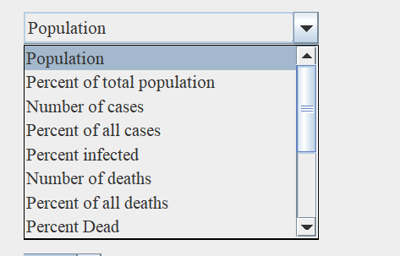
GUI：Input
KY

Slide 17
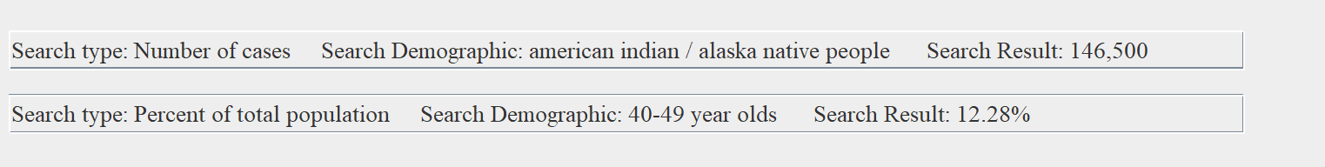
GUI:Output
KY

Slide 18
Challenges
G.F.
Communication
Finding times to meet
Contacting each other
Logistics
Making sure files were up to date
Hard to make small changes
Waiting for dependencies
Date base
Making sure everyone got the data in correctly
Couldn't get connectivity information from .properties file for the web project
Had to hard code it in to DBWorker instead

Slide 19
Successes
AYC
Project Successes
Met due date
Met requirements
Project came together when all the parts were combined
Incorporated MVC model successfully
Team/Communications Successes
Good Work Ethic amongst group members
Set up productive meetings so stay on track with group
Work was distributed evenly

Slide 20
Summary
KY
What we learned:
With the right class design, several people can work on a project simultaneously
Best to minimize dependencies for each class
Good communication is very important
There's nothing wrong with getting help from your team
If we had more time, what would we implement?
Nicer front and end design for the web and GUi interface
More Search types
Less hard-coding

